Slide 1
Programming For Finance
An introduction to Analyzing Financial Data Using common programming languages

Slide 2
Table of Contents
Introduction
Functions in Excel
SQL for data manipulation
Financial data analysis in Python (w/ Yahoo Finance API)

Slide 3
Introduction
Uses of software in finance

Slide 4
Software for financial analysis
Microsoft suite (Excel, PowerPoint, Word) Utilized to build data models (e.g. DCF) and to present analytics to stakeholders
Python and C++ to create financial analysis products for a variety of uses. Specifically utilized due to simplicity and speed / efficiency

Slide 5
Sell-Side Software Use
Deals with creation, promotion, and selling of traded securities to the public
Example: Market Makers that provide liquidity in markets
Technology used to execute trades, keep track of markets, price financial products

Slide 6
Hedge funds, Quants, etc.
Buy-Side firms that try and make money in markets
Use software to track market trends, notify traders of opportunities, execute strategies

Slide 7
Excel

Slide 8
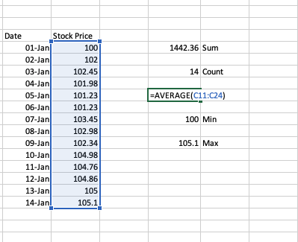
A few formulas
Sum, Count, Average, Min, Max
= ___(Range)

Slide 9
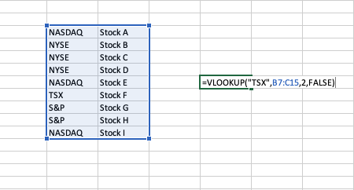
VLOOKUP
Find what you need within a range of values
=VLOOKUP(value you want, range to look for it, return column number, optional: exact or approximate match)

Slide 10
Pivot tables & Pivot charts
Visualize the dataset you're working with by breaking it up into an organized table and corresponding chart

Slide 11
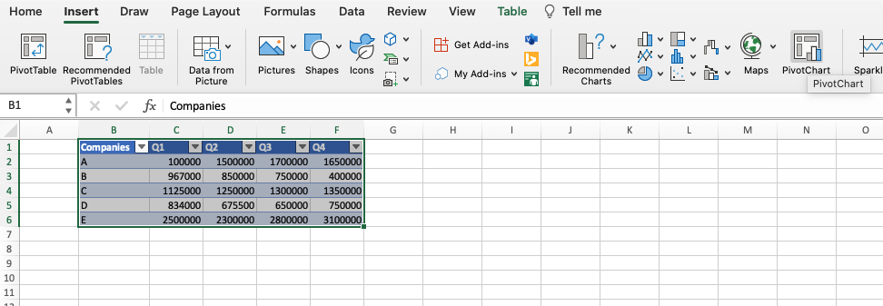
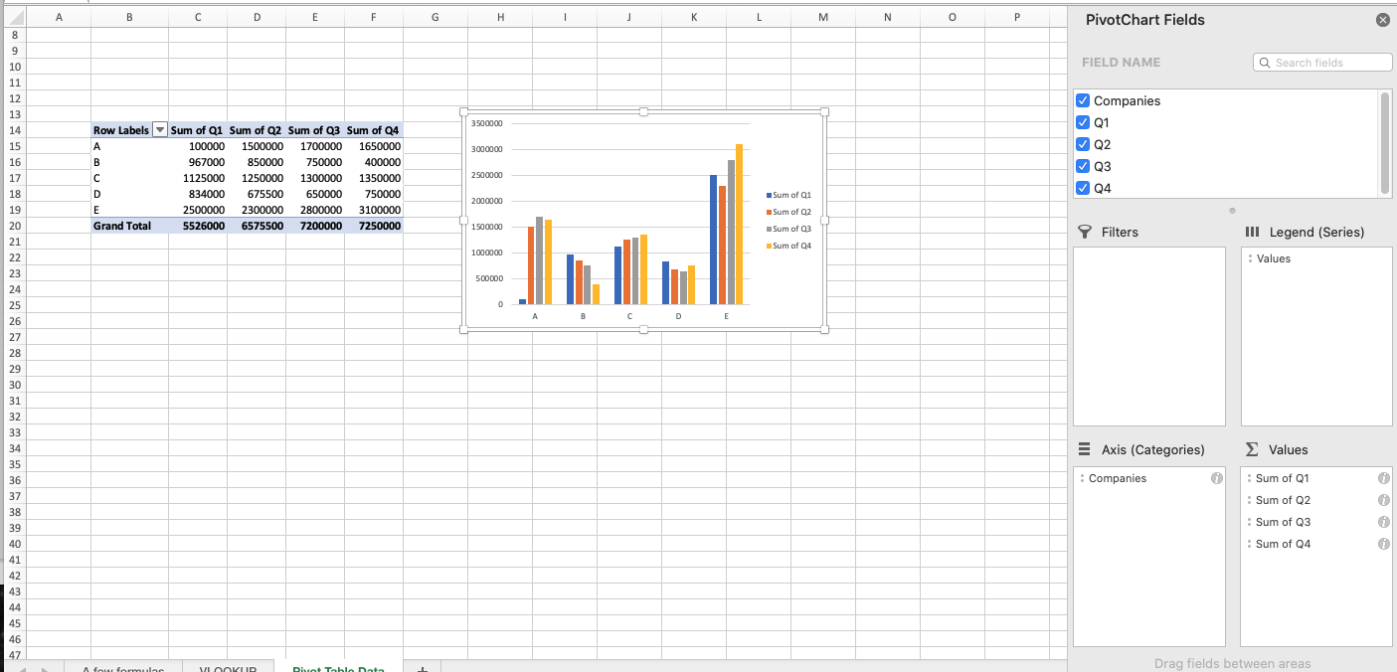

Slide 12
Power Query
Allows user to directly manipulate the table that data is presented in
Can merge & append multiple tables together, create custom columns on pre-existing tables, etc

Slide 13
SQL

Slide 14
SQL vs. Excel
Different situations might require different uses
SQL may be useful on large datasets that make it slow to run in Excel, whereas Excel would work if you want to view granular data values

Slide 15
Basic Query functions
Query searches can follow a format:
SELECT (data you need) FROM (specify database) WHERE (conditional statement)
Essentially, this format allows you to select the specific data you need from the specific database you want to grab the data from with an optional WHERE statement that allows you to filter the data that's received

Slide 16
SELECT stock_prices
FROM database
WHERE stock_symbol="FB";
Output: 352.65
Stock_symbol | Stock_prices
MSFT | 280.57
FB | 352.65
AAPL | 145.69
TSLA | 671.16

Slide 17
Math functions
ABS, AVG, COUNT, FLOOR, MAX/MIN
Can do calculations while data is retrieved

Slide 18
SELECT AVG(stock_dividends) FROM database
Output: 1.20
Stock_dividends
1.67
1.25
1.08
0.97
1.05

Slide 19
Pattern searching
Adding onto the ability of the WHERE statement
Using Wildcards, can filter data based on certain pattern that all data points have

Slide 20
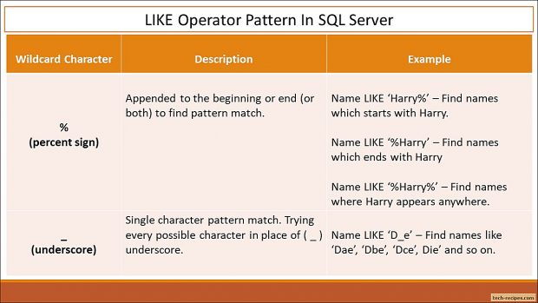
Pattern Searching Symbols

Slide 21
Pattern Searching Symbols
'%' signals that the rest of the pattern can be composed of whatever
'_' specifies that data must be in certain location
'|' gives pattern matching alternative choices
Can use Regex to get very specific search results

Slide 22
SELECT ticker
FROM database
WHERE ticker LIKE 'A%'
Output: AMZN, AMD
ticker
AMZN
AMD
BBY
ZM
INTC

Slide 23
Table JOINS
Ability to join two tables together in a variety of ways
Inner, left, right, and outer join

Slide 24
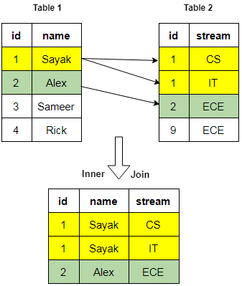
SELECT * FROM Table_1
INNER JOIN Table_2
ON Table_1.id = Table_2.id

Slide 25
Python

Slide 26
Yahoo Finance API
Multiple APIs online for market data and stock analysis
Yfinance is an API that allows users to download historical market data from Yahoo Finance
From terminal, pip install yfinance
To use API, write "import yfinance as yf" at top of python script

Slide 27
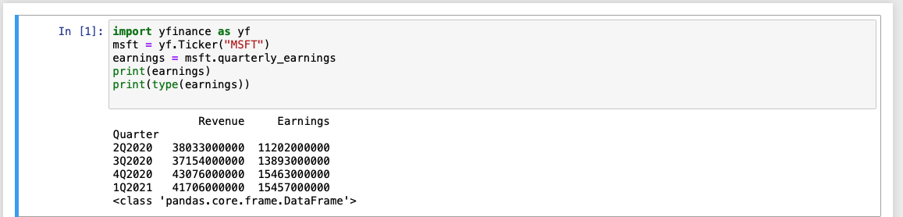

Slide 28
Pandas
"Python Data Analysis Library"
Used for data analysis. Allows importing of data into python from various formats such as csv files, JSON, and SQL
Can also be used for data manipulation

Slide 29
Introduction
Pip install pandas
Import pandas as pd

Slide 30
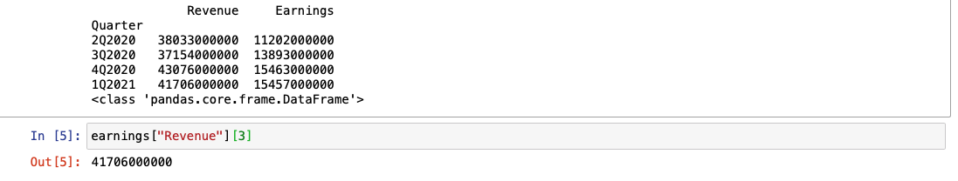
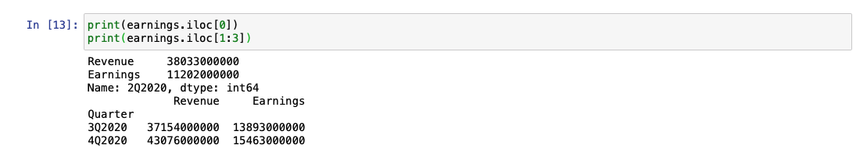
Selecting Rows and Columns

Slide 31
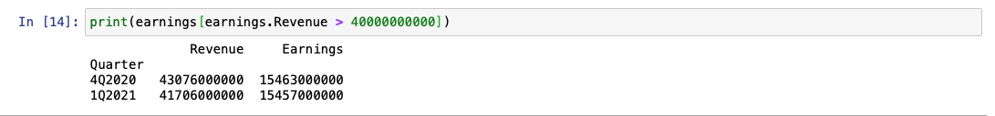
Selecting using logic

Slide 32
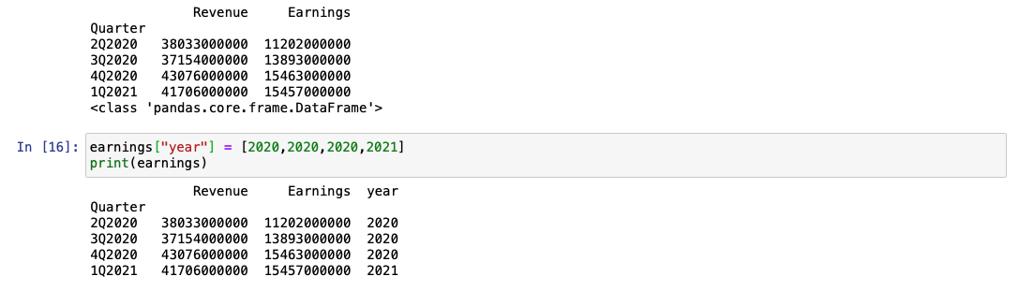
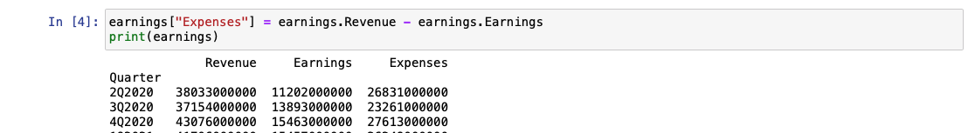
Adding Columns

Slide 33
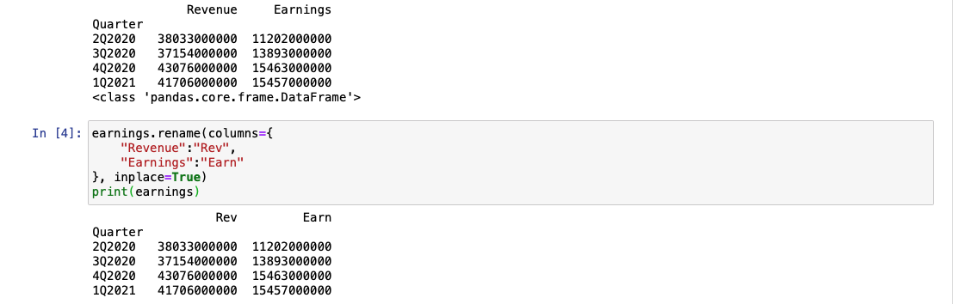
Renaming Columns

Slide 34
NumPy
Stands for Numerical Python
Library for python that supports large, multi-dimensional arrays and matrices
Use Case Example: Storing asset prices into matrix form for later use

Slide 35
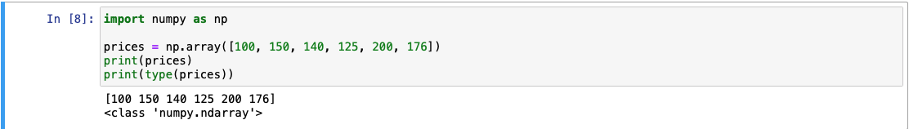
Creating a NumPy Array

Slide 36
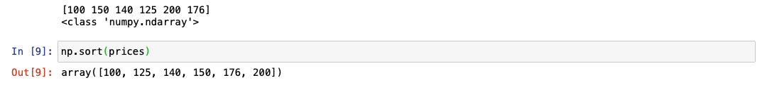
Sorting elements in array

Slide 37
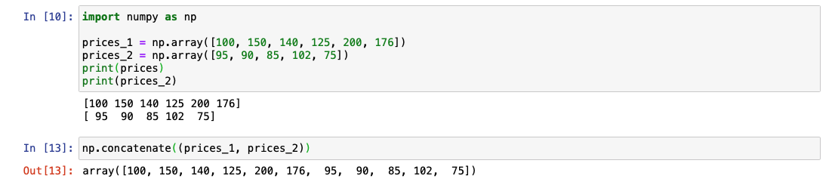
Concatenating two arrays together

Slide 38
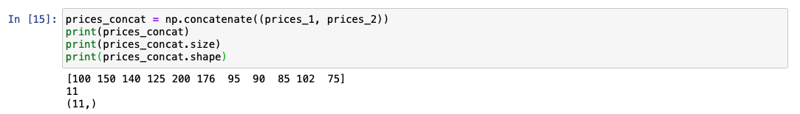
Getting info on array

Slide 39
Matplotlib
Data visualization library for Python
Can be used with NumPy in order to plot different datasets

Slide 40
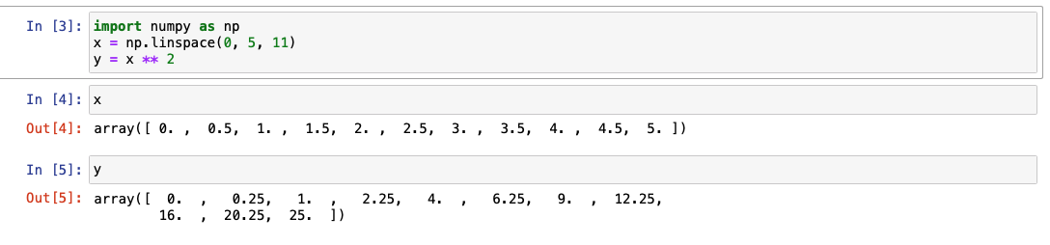
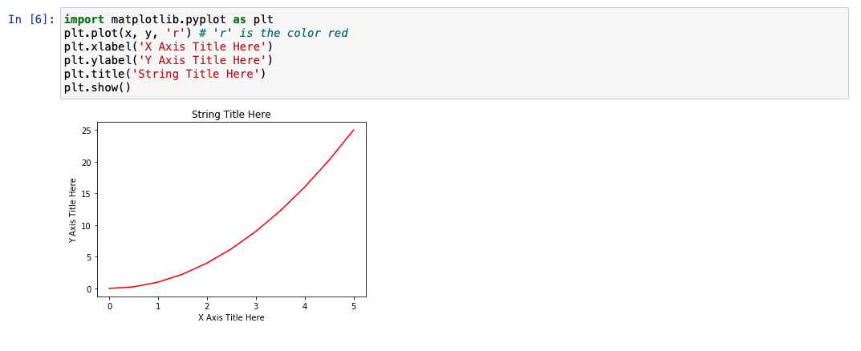
Creating arrays to be plotted
Plotting the data

Slide 41
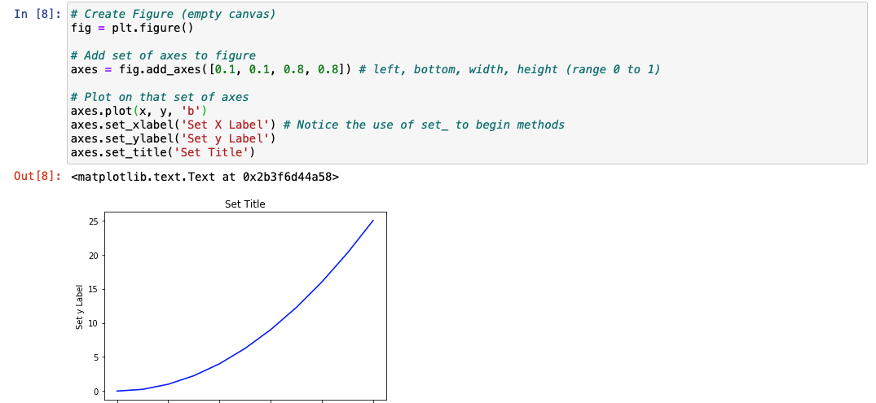
More object-oriented approach

Slide 42
Conclusion

Slide 43
Documentation
https://support.microsoft.com/en-us/excel
https://dev.mysql.com/doc/refman/8.0/en/
https://docs.python.org/3/

Slide 44
Created by:
https://github.com/michaelzheng67
www.linkedin.com/in/michaelzheng-

